Slide 1
Recursion
Data Structure
Asst.Prof.Dr.
Festim Halili

Slide 2
Introduction
A programming technique in which a function calls itself.
One of the most effective techniques in programming.

Slide 3
Recursive Definitions
N!, for any positive integer N, is defined to be the product of all integers between 1 and N inclusive
This definition can be expressed recursively as:
1! = 1
N! = N * (N-1)!
The concept of the factorial is defined in terms of another factorial
Eventually, the base case of 1! is reached

Slide 4
Recursive Definitions
5!
5 * 4!
4 * 3!
3 * 2!
2 * 1!
1
120
24
6
2
1

Slide 5
Recursive Programming
A method in Java can invoke itself; if set up that way, it is called a recursive method
The code of a recursive method must be structured to handle both the base case and the recursive case
Each call to the method sets up a new execution environment, with new parameters and local variables
As always, when the method completes, control returns to the method that invoked it (which may be an earlier invocation of itself)

Slide 6
Recursive Programming
N
N-1
N-2
= N +
= N + (N-1) +
i = 1
i = 1
i = 1
= etc.
Consider the problem of computing the sum of all the numbers between 1 and any positive integer N
This problem can be recursively defined as:

Slide 7
Recursive Programming
Lecture 10
result = 6
main
sum(3)
sum
result = 3
sum(2)
sum
result = 1
sum(1)
sum

Slide 8
Triangular Numbers
Consider the numbers 1, 3, 6, 10, 15….
What is so peculiar about them?
The n^{th} term in the series is obtained by adding n to the previous number.
Recursion can be used to find the nth term.

Slide 9
Finding nth Term
Using Loop int triangle(int n) { int total = 0; while (n > 0) { total = total + n; --n; } return total; } | Using Recursion int triangle(int n) { if(n == 1) { return 1; } else return(n + triangle(n-1)); }

Slide 10
Our observation (between loop vs. recursion)
If a loop is used, the method cycles around the loop n times, adding n to the total the first time, n-1 the second time and so on, down to 1, quitting the loop when n becomes 0.
If recursion is used, then a base case is used that determines when the recursion ends.

Slide 11
Iterative Factorial
CMSC 202
Iterative definition
N! = N * (N-1) * (N-2) * … * 3 * 2 * 1
    int factorial (int n)
    {
    int i, result;
    result = 1;
    for (i = 1; i <= n; i++) {
    result = result * i;
    }
    return ( result );
    }

Slide 12
Recursive Factorial
CMSC 202
Recursive N! definition
N! = 1 if N = 0
= N * (N-1)! Otherwise
int factorial ( int n)
{
if (n == 0)
return (1);
return (n * factorial(n - 1) );
}

Slide 13
Iterative vs Recursive factorial
CMSC 202
Iterative
2 local variables
3 statements
Saves solution in an intermediate variable
Recursive
No local variables
One statement
Returns result in single expression
Recursion simplifies factorial by making the computer do the work.
What work and how is it done?

Slide 14
Characteristics of Recursive Methods
The recursive method calls itself to solve a smaller problem.
The base case is the smallest problem that the routine solves and the value is returned to the calling method. (Terminal condition)
Calling a method involves certain overhead in transferring the control to the beginning of the method and in storing the information of the return point.
Memory is used to store all the intermediate arguments and return values on the internal stack.
The most important advantage is that it simplifies the problem conceptually.

Slide 15
Mathematical Induction
Recursion is programming equivalent of mathematical induction, which is a way of defining something in terms of itself.
It is valid provided there is a base case.

Slide 16
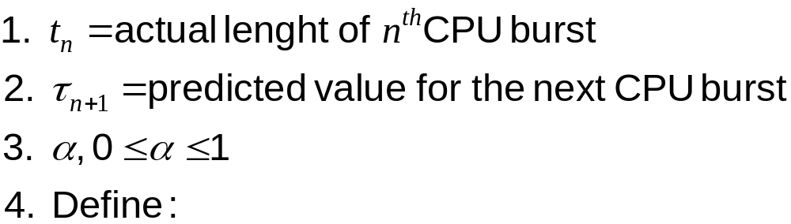
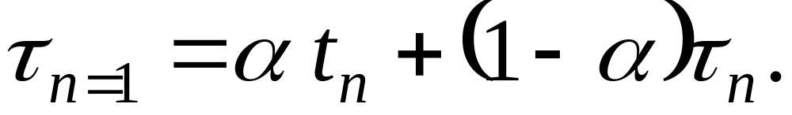
Example (math induction)
CPU burst prediction in scheduling

Slide 17

Prediction of the Length of the Next CPU Burst

Slide 18
Factorials
Factorials are similar to triangle, addition being replaced by multiplication and the base case is when input is 0.
The factorial of n is found by multiplying n with the factorial of n-1.
E.g. factorial of 3 = 3 * 2 * 1.
Factorial of 0 is defined as 1.

Slide 19
Anagrams
Anagramming a word is arranging letters of the word in different orders.
E.g anagramming cat gives: cat, cta, atc, act, tca, tac.
The strategy to achieve this is as follows:
  -- The number of possibilities is the factorial of the number of letters.
  -- the rightmost n-1 letters are anagrammed.
  -- Rotate all n letters, shifting all the letters one position left except for the leftmost letter which rotates back to the right.
  -- Repeat these steps n times.
Rotating the word gives each letter the chance to begin the word.
While the selected letter occupies the first position, all the other letters are then anagrammed.

Slide 20
Anagrams Contd.
We must rotate back to the starting point with two letters before performing a three-letter rotation.
The rightmost n-1 letters are anagrammed by recursion.
The base case occurs when the size of the word to be anagrammed is only one letter.

Slide 21
Recursive Binary Search
Binary search can also be implemented using recursion.
The method can call itself with new starting and ending values.
The base case is when the starting value is greater than the end value.

Slide 22
Fibonacci Numbers
CMSC 202
The Fibonacci numbers can be recursively
defined by the rule:
fib(n) = 0 if n is 0,
= 1 if n is 1,
= fib(n-1) + fib(n-2) otherwise
For example, the first seven Fibonacci numbers are
Fib(0) = 0
Fib(1) = 1
Fib(2) = Fib(1) + Fib(0) = 1
Fib(3) = Fib(2) + Fib(1) = 2
Fib(4) = Fib(3) + Fib(2) = 3
Fib(5) = Fib(4) + Fib(3) = 5
Fib(6) = Fib(5) + Fib(4) = 8

Slide 23
Tree Recursive Fibonacci
CMSC 202
// Note how the pending operation (the +)
// needs a 2nd recursive call to fib
int fib(int n)
{
if (n == 0) return 0;
if (n == 1) return 1;
return ( fib ( n – 1 ) + fib ( n – 2 ) );
}

Slide 24
Tree Recursive Count_42s
CMSC 202
int count_42s(int array[ ], int low, int high)
{
if ((low > high)
|| (low == high && array[low] != 42)) {
return 0 ;
}
if (low == high && array[low] == 42) {
return 1;
}
return (count_42s(array, low, (low + high)/2) +
count_42s(array, 1 + (low + high)/2, high)) );
}

Slide 25
Converting Recursive Functions to Tail Recursion
CMSC 202
A non-tail recursive function can often be converted to a tail recursive function by means of an “auxiliary” parameter that is used to form the result.
The idea is to incorporate the pending operation into the auxiliary parameter in such a way that the recursive call no longer has a pending operations (is tail recursive)

Slide 26
Tail Recursive Fibonacci
CMSC 202
int fib_aux ( int n, int next, int result )
{
if ( n == 0 ) return result;
return ( fib_aux ( n - 1, next + result, next ));
}
int fib ( int n )
{
return fib_aux ( n, 1, 0 );
}

Slide 27
Divide-and-Conquer
Recursive binary search is an example of divide – and – conquer.
The idea is to divide the bigger problem into smaller problems and solve each one separately.
The solution to each smaller problem is to divide it into even smaller problems and solve them.
The process continues till the base case is reached.
It can be used with recursion as well as non recursion.

Slide 28
Towers of Hanoi
Problem that consists of a number of disks placed on three columns.
The disks have different diameters and holes in the middle so they will fit over the columns.
All the disks start out on the first column.
The object of the problem is to transfer all the disks from first column to last.
Only one disk can be moved at a time and no disk can be placed on a disk that’s smaller than itself.

Slide 29
Solution
Assume that you want to move all the disks from a source tower, S to a destination tower, D.
Assume an intermediate tower, I.
Assume n disks on S.
Move the subtree consisting of the top n-1 disks from S to I.
Move the remaining (largest) disk from S to D.
Move the subtree from I to D.

Slide 30
Mergesort
The heart of mergesort algorithm is the merging of two already sorted arrays.
Merging two sorted arrays A and B creates a third array C that contains all the elements of A and B arranged in sorted order.
The idea is to divide an array in half, sort each half, and then use the merge method to merge the two halves into a single sorted array.
To sort the half arrays, call the sorting method recursively, dividing the arrays into quarters, so on and so forth.

Slide 31
Efficiency
Mergesort runs in O(N*logN) time.
Assuming that the number of items is a power of 2, for each individual merging operation, the maximum number of comparisons is always less than the number of items being merged, minimum is half the number of items being merged.

Slide 32
Eliminating Recursion
Some algorithms use recursive methods, some don’t.
Often an algorithm is easy to conceptualize as a recursive method, but in practice the recursive method might prove to be inefficient.
In such cases, it is useful to transform the recursive approach into a non-recursive approach.
Such transformation makes use of stack.

Slide 33
Recursion and Stacks
Most compilers implement recursion using stacks.
When a method is called the compiler pushes the arguments to the method and the return address on the stack and then transfers the control to the method
When the method returns, it pops these values off the stack
The arguments disappear and the control returns to the return address.

Slide 34
Recursive Applications
Raising a Number to a Power
The Knapsack problem: This involves trying to fit items of different weights into a knapsack so that the knapsack ends up with a specified total weight.
Combinations: Picking a Team. A combination is a selection of things in which their order doesn’t matter.

Slide 35
Knapsack Problem
Algorithm:
-- Start by selecting the first item. The remaining items must add up to the knapsack’s traget weight minus the first item; this is a new target weight.
-- Try one by one, each of the possible combinations of the remaining items.
-- If none of the combinations work, discard the first item, and start the whole process again with the second item.
-- Continue this with the third item and so on until you’ve tried all the combinations at which point you know there is no solution.
-- If at any point in this process the sum of the items you selected adds up to the target, you are done.

